Slide 1
Kix Business Dashboard
I’ve just completed an in-depth analysis of product sales data, and I’m eager to share the insights and learnings from this project. Here are some highlights:
📊 Objectives:
Identify sales trends and patterns across different regions and time periods
Analyze factors influencing product performance
Provide actionable insights to optimize sales strategies

Slide 2
Tools Used
Excel
And Used a Macro Record for open and close a filter panel
Power Query to connect with the data and transform it
Creating date table for the order date , calculations Table for some of the calculation used in the project

Slide 3
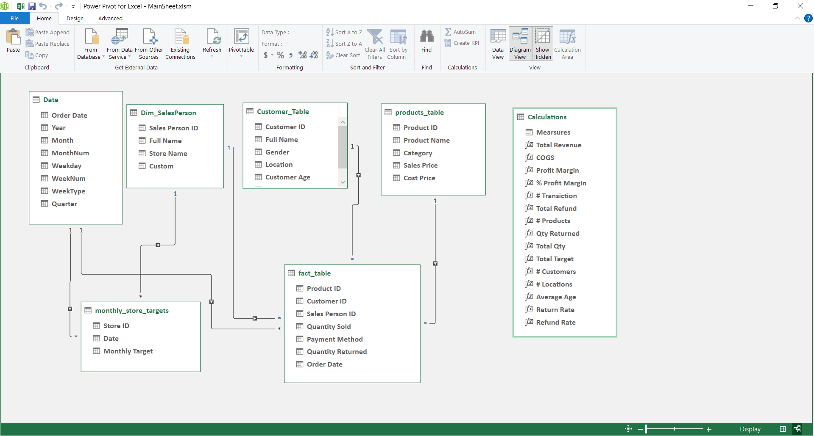
The Dataset diagram view and Relationships

Slide 4
Store Dashboard
Showing Total Revenue Vs Total Target by Store Name
KPIS -> Total Revenue , Total Target
Store Budget vs Revenue -> Presents a comparison of revenue vs. target for each store, which helps in understanding which stores are under or over-performing against their targets.
Month-by-Month Analysis (Filter) -> Offers a detailed month-by-month breakdown of total revenue and targets, highlighting variances. This can be important for financial planning and performance management.

Slide 5
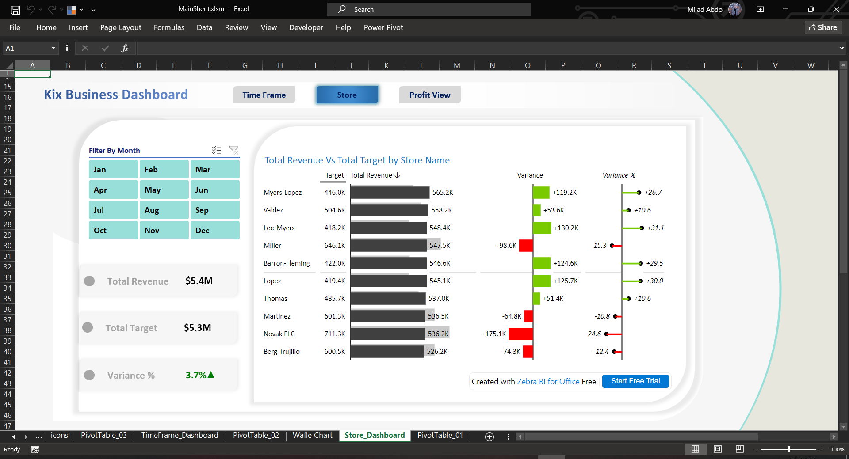

Slide 6
Profit Dashboard
KPIS -> Total Revenue , Profit Margin , Profit % , COGS
Customer analysis
provide insights into the profit generated from male and female customers, and
breaks down the average spending by customer age groups, showing which age groups are most profitable.
Showing top 5 customers and locations are most profitable for the company
Time frame
This includes a profit trend and month-over-month growth rate, which could help in identifying seasonal patterns or trends in sales effectiveness.
Analyzes which days of the week generate the most profit, useful for staffing and marketing efforts.
Product analysis
Details the top-selling and most profitable products, as well as product return and refund rates. This is critical for inventory management and identifying which products are most valuable to the business.

Slide 7
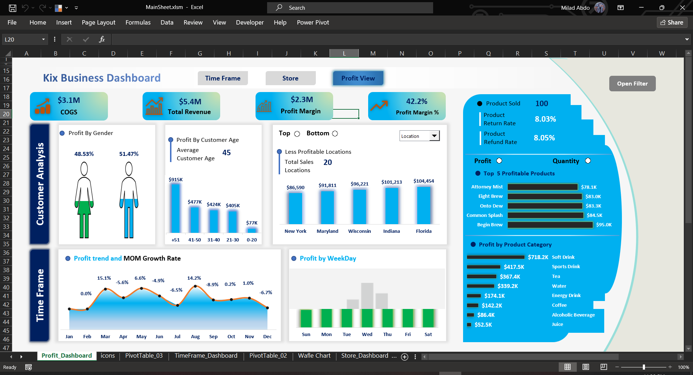

Slide 8
Timeframe Dashboard
Showing Total Revenue Vs Total Target by Month
KPIS -> Total Revenue , Profit Margin , Profit % , COGS
Quarterly Revenue Analysis -> Shows revenue generated per quarter against the average, providing a quick view of performance relative to the norm.
Weekday/Weekend Revenue Analysis -> Gives a comparison of revenue generated on weekdays versus weekends, which can help in making staffing and operational decisions.
Monthly Revenue vs Target -> Tracks monthly performance against goals, which is fundamental for short-term financial planning and adjustments.

Slide 9
